Slide 1
CAPSTONE PROJECT
Breast Cancer
Presented By:
Student Name - SUBHASHRI.M
College Name - MADHA ENGINEERING COLLEGE
Department - BIOTECHINOLOGY

Slide 2
OUTLINE
Problem Statement
Proposed System/Solution
System Development Approach
Algorithm & Deployment
Result
Conclusion
Future Scope
References

Slide 3
PROBLEM STATEMENT
Breast cancer is one of the most common cancers among women worldwide, with early detection being crucial for successful treatment. However, traditional diagnostic methods such as mammography can be costly, time-consuming, and may not always be accessible, especially in resource-constrained settings. Therefore, there is a pressing need for an accurate and efficient method for early detection of breast cancer.The aim of this project is to develop a machine learning model that can accurately detect breast cancer using clinical data and imaging techniqu

Slide 4
PROPOSED SOLUTION
One proposed solution for breast cancer detection is the use of artificial intelligence and machine learning algorithms to analyze medical imaging data, such as mammograms, to identify suspicious areas or patterns indicative of cancer. These algorithms can assist radiologists in interpreting images more accurately and efficiently, potentially leading to earlier detection and improved outcomes for patients. Additionally, advancements in genomic testing and biomarker analysis offer promising avenues for personalized medicine and targeted therapies in breast cancer detection and treatment.

Slide 5
SYSTEM APPROACH
A systems approach for breast cancer involves considering the disease not just at the level of the tumor itself, but also in the context of the entire biological system of the body. This includes understanding interactions between genes, cells, tissues, organs, and the patient's overall health. It encompasses various aspects such as prevention, early detection, diagnosis, treatment, and survivorship, while taking into account individual differences and personalized medicine approaches. It also involves interdisciplinary collaboration among healthcare professionals, researchers, patients, and caregivers to develop comprehensive strategies for prevention, diagnosis, and treatment.

Slide 6
ALGORITHM & DEPLOYMENT
Breast cancer detection algorithms typically involve several steps
Data Collection: Gathering mammogram images or other relevant medical data.
Preprocessing: Cleaning and preparing the data for analysis. This might involve resizing images, removing noise, or standardizing the format.
Feature Extraction: Identifying relevant features from the images or data that could indicate the presence of breast cancer. This could include texture analysis, shape analysis, or intensity variations.
Machine Learning Models: Utilizing machine learning techniques such as logistic regression, support vector machines, or deep learning neural networks to train a model on the extracted features.
Training: Splitting the data into training and testing sets, then using the training data to teach the algorithm to recognize patterns associated with breast cancer.

Slide 7
Validation: Assessing the performance of the model using the testing data to ensure it generalizes well to new, unseen data.
Optimization: Fine-tuning the model parameters to improve its performance.
Deployment: Implementing the algorithm into a system that can be used for breast cancer screening in clinical settings.
Development of such algorithms involves collaboration between computer scientists, medical professionals, and data scientists to ensure accuracy, reliability, and clinical relevance. Continuous refinement and validation are essential to ensure the algorithm’s effectiveness in real-world scenarios. Additionally, adherence to ethical guidelines and regulations regarding patient data privacy and medical device development is crucial throughout the process.
.

Slide 8
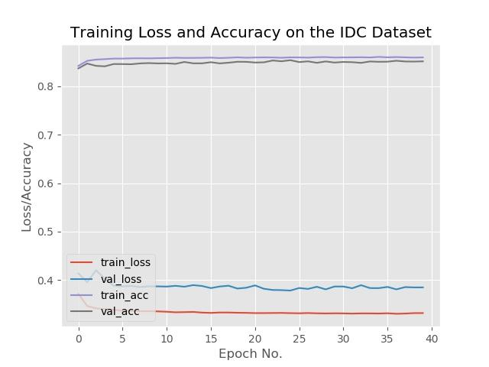
RESULT

Slide 9
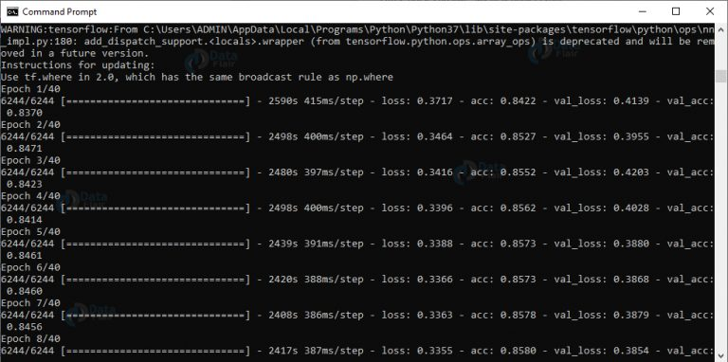

Slide 10
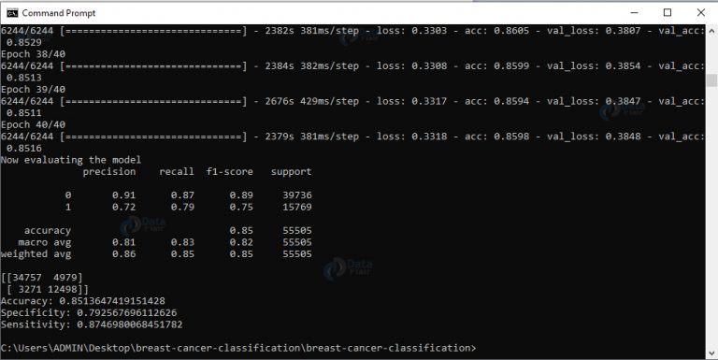

Slide 11
CONCLUSION
Breast cancer detection has evolved significantly with the integration of advanced algorithms and technologies. From traditional mammography to sophisticated machine learning models, the goal remains consistent: to improve early detection rates and save lives. By leveraging image processing techniques, machine learning algorithms, and clinical data analysis, healthcare professionals can enhance the accuracy and efficiency of breast cancer screening and diagnosis. Moreover, the development of mobile apps, telemedicine solutions, and genetic screening further empowers individuals and healthcare providers to detect breast cancer early, personalize treatment plans, and ultimately improve patient outcomes. However, continuous research, development, and collaboration are essential to further refine these algorithms and approaches, ensuring their effectiveness in detecting breast cancer at its earliest and most treatable stages.

Slide 12
FUTURE SCOPE
The future scope for breast cancer detection is promising, with advancements in various technologies such as:Artificial Intelligence (AI) and Machine Learning (ML): AI algorithms are being developed to analyze mammograms and other imaging data with high accuracy, aiding in early detection and reducing false positives.Genomic Testing: Genomic testing helps identify specific genetic mutations associated with breast cancer, enabling personalized treatment plans and targeted therapies.Advanced Imaging Techniques: Innovations in imaging technologies, such as tomosynthesis and contrast-enhanced MRI, provide clearer and more detailed images for detecting small tumors and evaluating treatment response.Nanotechnology: Nanoparticles and nanosensors are being developed for early cancer detection by detecting biomarkers in the bloodstream or tissues with high sensitivity and specificity.By leveraging these advancements, the future of breast cancer detection holds the promise of earlier diagnosis, more personalized treatment approaches, and improved outcomes for patients.

Slide 13
REFERENCES
https://www.kaggle.com/uciml/breast-cancer-wisconsin-data
https://github.com/neha-2568/Detection-of-Breast-Cancer
https://github.com/neha-2568/Detection-of-Breast-Cancer

Slide 14
THANK YOU

